Slide 1
Mini project 4
16236300
Prudhvi sai suggala

Slide 2
Part A
Hidden layersize , epochs | Sparsity regularization | Classification Error | Auc |  | Ratio
(500,400)(125,400) | (4,0.04;0.002,2.5) | 6.9 | 0.94207 |  | 176.58
(1000,400)(400,200)(100,200) | (0.04,0.15;) | 7.5 | 0.94156 |  | 105.67
(400,400)(400,400) |  | 5 | 0.9467 |  | 189.34
(100,150)(125,400) |  | 8.9 | 0.9326 |  | 153.64

Slide 3
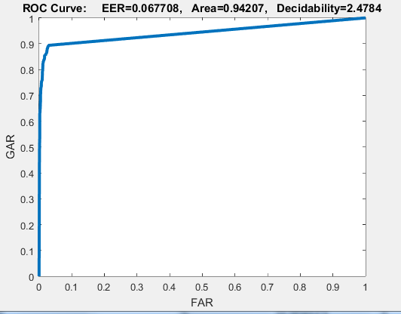
Deepnet 1
hiddenSize1 = 500;
'L2WeightRegularization‘=0.04
'SparsityRegularization‘=4
'SparsityProportion‘=0.15
hiddenSize2 =125;
'MaxEpochs',400, ...
'L2WeightRegularization‘=0.002
'SparsityRegularization‘=2.5
'SparsityProportion‘=0.1

Slide 4
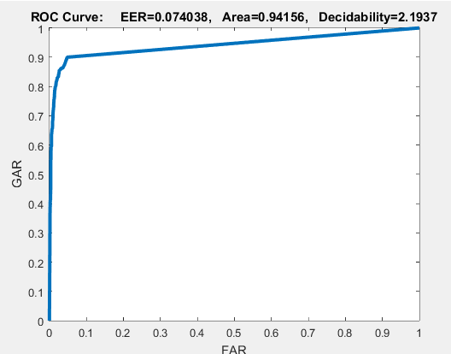
Deepnet 2
hiddenSize1 = 1000;
'L2WeightRegularization‘=0.04
'SparsityRegularization‘=4
'SparsityProportion‘=0.15
hiddenSize2 =400;
'MaxEpochs',400,
'L2WeightRegularization‘=0.002
'SparsityRegularization‘=3
'SparsityProportion‘=0.1
hiddenSize2 =100;
'MaxEpochs',400,
'L2WeightRegularization‘=0.01
'SparsityRegularization‘=3
'SparsityProportion‘=0.1

Slide 5
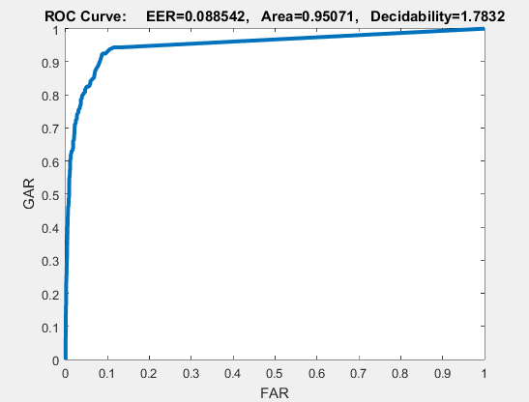
Deepnet 3
hiddenSize1 = 400;
'L2WeightRegularization‘=0.002
'SparsityRegularization‘=2
'SparsityProportion‘=0.3
hiddenSize2 =400;
'MaxEpochs',400,
'L2WeightRegularization‘=0.004
'SparsityRegularization‘=3
'SparsityProportion‘=0.1

Slide 6
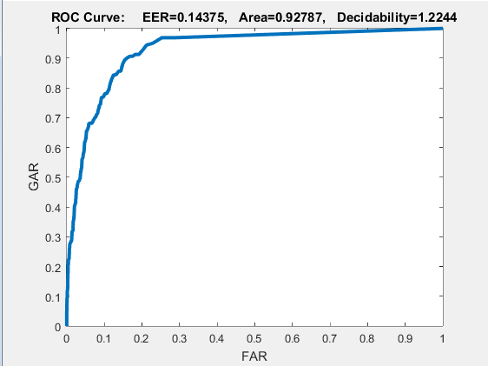
Deepnet 4
hiddenSize1 = 100;
'L2WeightRegularization‘=0.04
'SparsityRegularization‘=4
'SparsityProportion‘=0.15
hiddenSize2 =125;
'MaxEpochs',400,
'L2WeightRegularization‘=0.002
'SparsityRegularization‘=3
'SparsityProportion‘=0.1

Slide 7
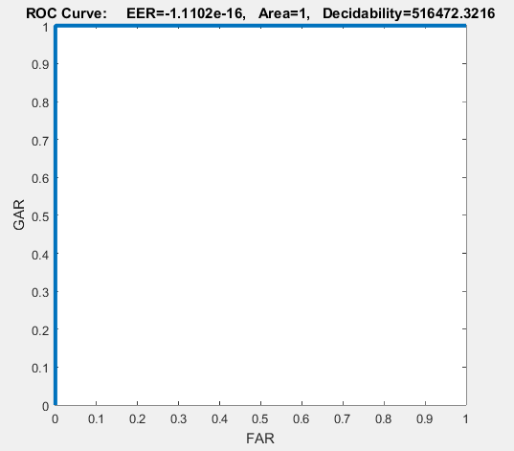
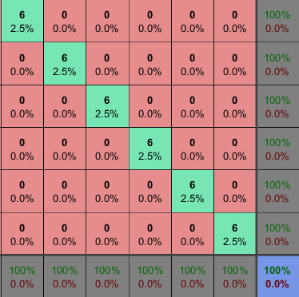
Part B
Training Roc and confusion matrix for 40 subjects

Slide 8
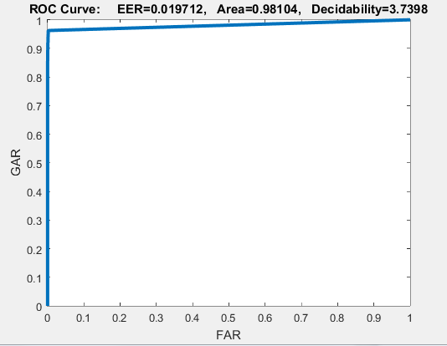
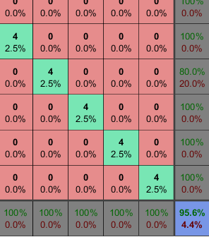
Testing Roc and confusion matrix of 40 subjects trained in independent way

Slide 9
Part 3
Used score fusion technique with three parallel deepnets outputs helps to improve overall roc and minimize classification error
Used 3 deeps nets with score fusion which had resulted in 4 % increase in roc
[y1_train,y1_test]=deepnet(100,70,400,200,0.005,0.003,4,4,0.2,0.15); [y2_train,y2_test]=deepnet(120,80,350,180,0.004,0.002,4,4,0.15,0.1); [y3_train,y3_test]=deepnet(200,95,300,150,0.003,0.0015,4,4,0.1,0.08); y_train= (1/3).*(y1_train+y2_train+y3_train); y_test= (1/3).*(y1_test+y2_test+y3_test);

Slide 10
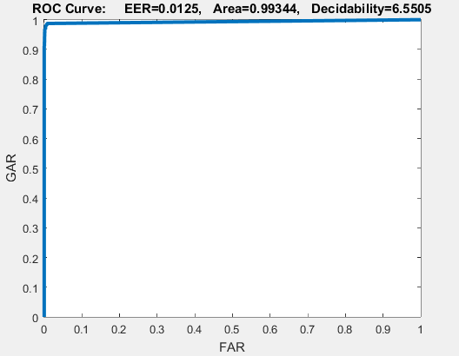
Roc of score fusion deepnet

Slide 11
Conclusion
Autoencoders help in capturing the pattern from data in a unsupervised learning fashion .
Key parameters like regularization and sparsity need to be considered in designing a auto encoders , Regularization reduces the overfitting of model to data .
Good improvement in performance after fine tuning a deep net after stacking with autoencoders

